Slide 1
Health Reimbursement Arrangement

Slide 2
What is a Health Reimbursement Arrangement (HRA)?
Employer-provided benefit account that pays for eligible medical deductible expenses
Plan 5 PPO hra
Plan 7 hdhp hra
Covers ONLY medical deductible expenses
Does NOT cover: medical copays, coinsurance, non-covered services; prescriptions; dental; vision; or over-the-counter expenses
Covers ONLY medical deductible and prescription expenses
Does NOT cover: dental; vision, or over-the-counter medications or expenses

Slide 3
The Plan 5 HRA will reimburse:
Employee only coverage: up to $800 of the $2,000 deductible for the Plan 5 PPO Group Health Plan.
Employee plus dependent coverage: up to $1,600 of the $4,000 deductible for the Plan 5 PPO Group Health Plan.
The Plan 7 HRA will reimburse:
Employee only coverage: up to $1,200 of the $3,000 deductible for the Plan 7 High Deductible Group Health Plan.
Employee plus dependent coverage: up to $2,400 of the $6,000 family deductible for the Plan 7 High Deductible Group Health Plan.

Slide 4
Your HRA
Full contribution available January 1, 2021
Plan Year
Service dates must fall between January 1, 2021 – December 31, 2021
Occasional substantiation requests
Explanations of benefits required
Use for anyone covered on your Anthem policy

Slide 5
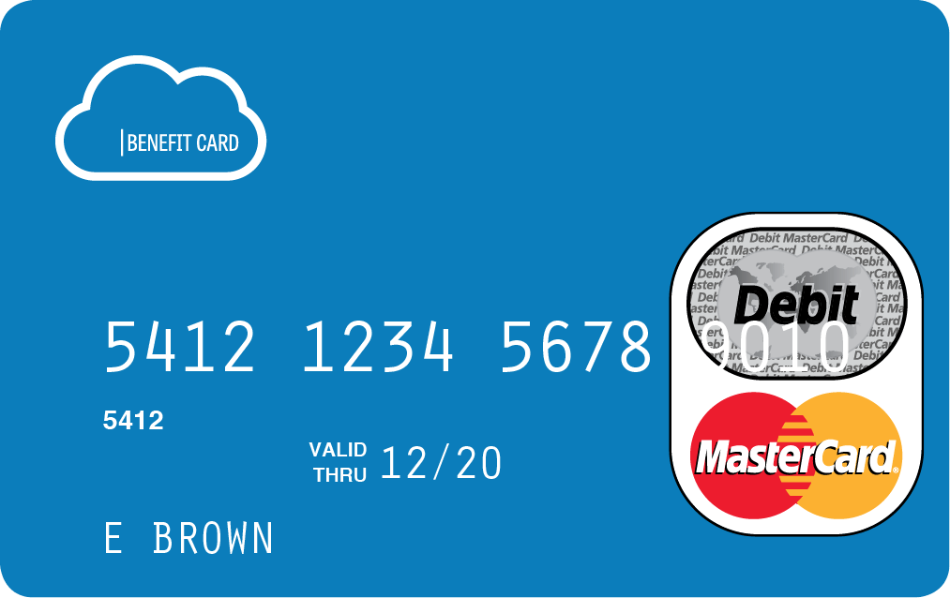
LD&B Benefits Card
Easy
a simple swipe of the card makes it hassle free!
Automatic
funds are immediately deducted from your HRA at the time you incur the expense.
Convenient
there are no manual claim forms to submit.
Simple to Track
consumer current balance is available 24/7 at the web site listed on the back of the card.

Slide 6
FSA Account Access on the Go
LD&B Mobile App and
Consumer Portal Access
Provides Additional Timing-Saving Options
View claims requiring receipts
Submit medical and dependent care FSA claims
Take a picture of a receipt and submit for a new or existing claim
Use the eligible expense scanner in your app to quickly find eligible items in the store
Easy, Convenient & Secure
Check available balances 24/7
View account details
Click to call or email Customer Service
Connects You with the Details
Simply login to the app using the your username and password (instructions provided upon enrollment)
No sensitive account information is ever stored on the mobile device; secure encryption is used to protect all transmissions
Notes:
Mobile app lets tech-savvy consumers manage their CDH accounts right from their phone.
Mobile adds a whole new dimension of flexibility for your “on-the-go” participants, giving them a convenient way to access their healthcare spending accounts – securely, at any time and from virtually anywhere.

Slide 7
Questions?
Enrollment is open now!
Contact your administrator: Megan Throngard
Phone: 877-532-5478 or Email: mthrongard@gmail.com
www.ldbbenefitsadmin.com | LD&B Benefits Administrators Mobile App | LD&B Consumer Portal

